Slide 1


• We’ll start in a moment :) • We are NOT recording tonight’s event. We may plan to take screenshots for social media. • If you want to remain anonymous, change your name & keep video off. • We’ll introduce the hosts and break in-between for Q/A. • We will make some time for Q&A at the end of the presentation as well. • You can come prepared with questions. And, feel free to take notes. • Online event best practices: • Don't multitask. Distractions reduce your ability to remember concepts. • Mute yourself when you aren’t talking. • We want the session to be interactive. • Feel free to unmute and ask questions in the middle of the presentation. • Turn on your video if you feel comfortable. • Disclaimer: Speaker doesn’t knows everything! Check out:
• Technical Tracks and Digital Events • Get updates – join the Digital mailing list • Give us your feedback – take the Survey
Copyright © 2021 by Madhurima Nath
Welcome!

Slide 2

Copyright © 2021 by Madhurima Nath
WWCode Digital + Backend
Backend Study Group
July 15, 2021

Slide 3


• Welcome from WWCode! • Our mission: Inspiring women to excel in technology careers. • Our vision: A world where women are representative as technical executives, founders, VCs, board members and software engineers.
• What is Backend Engineering? • Insights into data engineering, data science and machine learning engineering - Data engineering [Part 1 of 2] + Introduction + Similarities/Differences + Day in a life of data engineer + Tech stack - Data science and machine learning engineering [Part 2 of 2]
Introduction & Agenda
Prachi Shah
Senior Software Engineer @ Metromile
Madhurima Nath
Data Scientist @ Slalom
Copyright © 2021 by Madhurima Nath

Slide 4
• What is Backend Engineering?
• Design, build and maintain server-side web applications. • Concepts: Client-server architecture, API, micro-service, database engineering, distributed systems, storage, performance, deployment, availability, monitoring, etc.
Software Design • Defining the architecture, modules, interfaces and data. • Solve a problem or build a product. • Define the input, output, business rules, data schema. • Design patterns solve common problems. • 3 Types: • UI design: Data visualization and presentation. • Data design: Data representation and storage. • Process design: Validation, manipulation and storage of data.
Copyright © 2021 by Prachi Shah
Backend Engineering

Slide 5
Copyright © 2021 by Madhurima Nath
What is data engineering?
Data engineers
design and build pipelines to transform and transport data into a format readily useable by the data scientists or other end users.
pipelines take data from many disparate sources and collect them into a single warehouse that is the unified data source for others.
work closely with DevOps and data science/machine learning teams

Slide 6
Copyright © 2021 by Madhurima Nath
Data Engineer (DE) vs Data Scientist (DS) vs Machine Learning Engineer (MLE)
Data engineer:
builds and develops pipelines, and maintains of data infrastructure, either on-premises or in the cloud (or hybrid or multi-cloud), comprising of databases or data warehouses
Data scientist:
builds and develops mathematical and statistical models -- called machine learning models, to find patterns and gain more insights from the data
Machine learning engineer:
design architecture and pipelines (or software) to integrate and automate the process of running the models developed by data scientists with the entire infrastructure

Slide 7












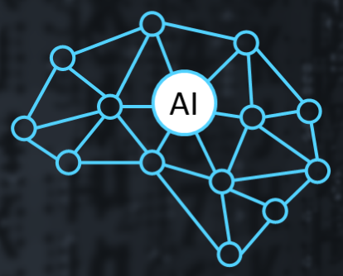






Copyright © 2021 by Madhurima Nath
Data Architecture Diagram
DATA CLEANING, PROCESSING, ANALYSIS, TRANSFORMATION
DATA SOURCES
USER INTERFACE
On premise or cloud EDW
EDW
Ingestion
.json
.xml
.csv
.txt
CLOUD PLATFORMS
AI/Machine Learning
Data Enhancement
Data Enrichment
Disclaimer: These can change based on companies/industry

Slide 8
Copyright © 2021 by Madhurima Nath
Data Architecture Diagram – Data Engineer
DATA CLEANING, PROCESSING, ANALYSIS, TRANSFORMATION
DATA SOURCES
On premise or cloud EDW
Data available for both analytics and visualization
EDW
Ingestion
.json
.xml
.csv
.txt
CLOUD PLATFORMS
Disclaimer: These can change based on companies/industry

Slide 9
Copyright © 2021 by Madhurima Nath
Data Architecture Diagram – Data Scientist
DATA CLEANING, PROCESSING, ANALYSIS, TRANSFORMATION
USER INTERFACE
On premise or cloud EDW
CLOUD PLATFORMS
AI/Machine Learning
Data Enhancement
Data Enrichment
Disclaimer: These can change based on companies/industry

Slide 10
Copyright © 2021 by Madhurima Nath
Data Architecture Diagram – ML Engineer
DATA CLEANING, PROCESSING, ANALYSIS, TRANSFORMATION
Automate and integrate with rest of the infrastructure
On premise or cloud EDW
Data available for both analytics and visualization
CLOUD PLATFORMS
AI/Machine Learning
Data Enhancement
Data Enrichment
Disclaimer: These can change based on companies/industry

Slide 11
Copyright © 2021 by Madhurima Nath
Who are Data Engineers (DE), Data Scientists (DS) and Machine Learning Engineers (MLE)?
You can unmute and talk or use the chat.

Slide 12
Copyright © 2021 by Madhurima Nath
Data Engineer (DE) vs Data Scientist (DS) vs Machine Learning Engineer (MLE)
Data engineer:
- Develops data ingestion pipelines
- Takes data from multiple sources and in multiple formats and combines to single source
Data scientist:
- Finds patterns in the data to obtain insights
- Builds machine learning models to further enhance understanding of data
Machine learning engineer:
- Develops scripts to integrate work of data scientists with the larger framework
- Automates the work of data scientist such that models can be triggered to run without a data scientist

Slide 13
Copyright © 2021 by Madhurima Nath
How do Data Engineers (DE), Data Scientists (DS) and Machine Learning Engineers (MLE) differ from each other?
You can unmute and talk or use the chat.

Slide 14
Copyright © 2021 by Madhurima Nath
How they are different/similar?
DE: Take data in a variety of formats, make it available in one queryable
Integration of the pipelines with the overall architecture
CI/CD
Data quality analysis
SQL queries
DS: Extensive data analysis, build ML models, perform statistical tests
MLE: Take ML models and deploy it using automated pipelines
Test different ML models
Disclaimer: These can change based on companies/industry

Slide 15
Copyright © 2021 by Madhurima Nath
NOTE
Data engineers, data scientists and machine learning engineers make use of existing/pre-built modules or libraries or functions.
They write their own functions or custom codes as well; however, not same as a software engineer or software developer.
Disclaimer: These can change based on companies/industry

Slide 16
Copyright © 2021 by Madhurima Nath
A Day in a Life of Data Engineer
Tasks:
make available in one place datasets ingested from a variety of sources in a variety of formats
build the data pipelines to ingest streaming and batch data from many sources
pipelines perform extract, transform, and load (ETL) processes to make the data more usable
convert from row-oriented formats to column-oriented formats to facilitate analytical queries, partition data, index it, tag it, govern it, etc.
Disclaimer: These can change based on companies/industry

Slide 17

Copyright © 2021 by Madhurima Nath
A Day in a Life of Data Engineer
make available in one place datasets ingested from a variety of sources in a variety of formats
INTERNAL
EXTERNAL
INTERNAL
.csv
.json
.xml
manual file sources
Enterprise Data Warehouse (EDW) – on premise or cloud (Snowflake)
*API: Application Programming Interface: lets your product or service communicate with other products and services without having to know how they’re implemented
.txt
Disclaimer: These can change based on companies/industry

Slide 18
Copyright © 2021 by Madhurima Nath
A Day in a Life of Data Engineer
make available in one place datasets ingested from a variety of sources in a variety of formats
.txt
.csv
.xml
.json
{
“text”:“RT@abcland: my best day ..”,
“created_at”:“Fri Apr 15 10:05:45
+0000 2020”,
“retweet_count”:0,
“id_str”:“561819028170009”,
“entities”: {
“user_mentions”: [],
“hashtags”: []
}, ….
….
}
<log date=May 01, 2021>
<message id=1>
<person id=01></person>
<text> hi, how are you </text>
<time> May 01, 2021-16:09:22
</time>
<\message>
…
…
Parquet
id name age\n
01 ABCD 28\n
02 XYZ 39\n
…
…
id,name,age
01,ABCD,28
02,XYZ,39
…
…

Slide 19
Copyright © 2021 by Madhurima Nath
A Day in a Life of Data Engineer
make available in one place datasets ingested from a variety of sources in a variety of formats
.txt
.csv
.xml
.json
{
“text”:“RT@abcland: my best day ..”,
“created_at”:“Fri Apr 15 10:05:45
+0000 2020”,
“retweet_count”:0,
“id_str”:“561819028170009”,
“entities”: {
“user_mentions”: [],
“hashtags”: []
}, ….
….
}
<log date=May 01, 2021>
<message id=1>
<person id=01></person>
<text> hi, how are you </text>
<time> May 01, 2021-16:09:22
</time>
<\message>
…
…
Parquet
id name age\n
01 ABCD 28\n
02 XYZ 39\n
…
…
id,name,age
01,ABCD,28
02,XYZ,39
…
…
Can you identify which data formats are structured/unstructured/semi-structured?
You can unmute and talk or use the chat.

Slide 20
Copyright © 2021 by Madhurima Nath
A Day in a Life of Data Engineer
make available in one place datasets ingested from a variety of sources in a variety of formats
.txt
.csv
.xml
.json
{
“text”:“RT@abcland: my best day ..”,
“created_at”:“Fri Apr 15 10:05:45
+0000 2020”,
“retweet_count”:0,
“id_str”:“561819028170009”,
“entities”: {
“user_mentions”: [],
“hashtags”: []
}, ….
….
}
<log date=May 01, 2021>
<message id=1>
<person id=01></person>
<text> hi, how are you </text>
<time> May 01, 2021-16:09:22
</time>
<\message>
…
…
Parquet
id name age\n
01 ABCD 28\n
02 XYZ 39\n
…
…
id,name,age
01,ABCD,28
02,XYZ,39
…
…
UNSTRUCTURED
SEMI-STRUCTURED
STRUCTURED

Slide 21
Copyright © 2021 by Madhurima Nath
A Day in a Life of Data Engineer
make available in one place datasets ingested from a variety of sources in a variety of formats
.txt
.csv
.xml
.json
{
“text”:“RT@abcland: my best day ..”,
“created_at”:“Fri Apr 15 10:05:45
+0000 2020”,
“retweet_count”:0,
“id_str”:“561819028170009”,
“entities”: {
“user_mentions”: [],
“hashtags”: []
}, ….
….
}
<log date=May 01, 2021>
<message id=1>
<person id=01></person>
<text> hi, how are you </text>
<time> May 01, 2021-16:09:22
</time>
<\message>
…
…
Parquet
id name age\n
01 ABCD 28\n
02 XYZ 39\n
…
…
id,name,age
01,ABCD,28
02,XYZ,39
…
…
Which data formats are more user-friendly?
Which data formats are more storage efficient?
You can unmute and talk or use the chat.

Slide 22
Copyright © 2021 by Madhurima Nath
A Day in a Life of Data Engineer
make available in one place datasets ingested from a variety of sources in a variety of formats
INTERNAL
INTERNAL
EXTERNAL
.txt
.csv
.xml
.json
Parquet
More efficient storage and performance
More flexible for users
UNSTRUCTURED
SEMI-STRUCTURED
STRUCTURED
Disclaimer: These can change based on companies/industry

Slide 23
Copyright © 2021 by Madhurima Nath
A Day in a Life of Data Engineer
Ingest data from internal and external sources – could be unstructured, semi-structured or structured and make it available at one place
INTERNAL
EXTERNAL
.txt
.csv
UNSTRUCTURED
.json
.xml
Enterprise Data Warehouse (EDW) – on premise or cloud (Snowflake)
.xml
.json
SEMI-STRUCTURED
.txt
STRUCTURED
Disclaimer: These can change based on companies/industry

Slide 24
Copyright © 2021 by Madhurima Nath
A Day in a Life of Data Engineer
Tasks:
build the data pipelines to ingest streaming and batch data from many sources
Streaming data – real-time –
e.g.: log files generated by customers using your mobile or web applications, ecommerce purchases, in-game player activity, information from social networks, financial trading floors, or geospatial services.

Slide 25

Copyright © 2021 by Madhurima Nath
A Day in a Life of Data Engineer
Tasks:
build the data pipelines to ingest streaming and batch data from many sources
Streaming data – real-time –
e.g.: log files generated by customers using your mobile or web applications, ecommerce purchases, in-game player activity, information from social networks, financial trading floors, or geospatial services.
from pyspark import SparkContext
from pyspark.streaming import StreamingContext
sc = SparkContext(master, appName)
ssc = StreamingContext(sc, 1)
“appName”: name for your application
“master”: Spark/local compute node
“1”: interval of 1 second
Calling pre-built spark functions
(https://spark.apache.org/docs/latest/streaming-programming-guide.html)

Slide 26
Copyright © 2021 by Madhurima Nath
A Day in a Life of Data Engineer
Tasks:
build the data pipelines to ingest streaming and batch data from many sources
Batch data – not real-time –
e.g.: very large amounts of data when data sources are legacy systems, moving data from databases/data warehouse to cloud.

Slide 27
Copyright © 2021 by Madhurima Nath
A Day in a Life of Data Engineer
Tasks:
build the data pipelines to ingest streaming and batch data from many sources
Batch data – not real-time –
e.g.: very large amounts of data when data sources are legacy systems, moving data from databases/data warehouse to cloud.
# read data in csv format
spark.read.format("csv")
.option("mode", "FAILFAST")
.option("inferSchema", "true")
.option("path", "path/to/file(s)")
.schema(someSchema)
.load()
# write the data as parquet format
dataframe.write.format(“parquet”)
.option("mode", "OVERWRITE")
.option("dateFormat", "yyyy-MM-dd")
.option("path", "path/to/file(s)")
.save()

Slide 28
Copyright © 2021 by Madhurima Nath
A Day in a Life of Data Engineer
Tasks:
build the data pipelines to ingest streaming (i.e., real-time) and batch data from many sources
Writing files/data
dataframe.write.format("csv")
.option("mode", "OVERWRITE")
.option("dateFormat", "yyyy-MM-dd")
.option("path", "path/to/file(s)")
.save()
Save modes –
append: add output to already existing file at the same location
overwrite: completely overwrite over existing data/file
errorIfExists: throw an error and fail if data/file already exists at the same location
ignore: do nothing, if data/file already exists

Slide 29

Copyright © 2021 by Madhurima Nath
A Day in a Life of Data Engineer
Tasks:
build the data pipelines to ingest streaming and batch data from many sources
Streaming data – real-time –
e.g.: log files generated by customers using your mobile or web applications, ecommerce purchases, in-game player activity, information from social networks, financial trading floors, or geospatial services.
# read data continuously from AWS S3 location
val inputDF = spark.readStream.json("s3://logs")
# write the data into MySQL database
inputDF.groupBy($"action", window($"time", "1 hour")).count()
.writeStream.format("jdbc")
.start("jdbc:mysql//…")
(https://databricks.com/blog/2016/07/28/structured-streaming-in-apache-spark.html)
Disclaimer: These can change based on companies/industry

Slide 30
Copyright © 2021 by Madhurima Nath
A Day in a Life of Data Engineer
Tasks:
build the data pipelines to ingest streaming and batch data from many sources
Batch data – not real-time –
e.g.: very large amounts of data when data sources are legacy systems, moving data from databases/data warehouse to cloud.
# read data in JSON format from AWS S3 location
val inputDF = spark.read.json("s3://logs")
# write the data into MySQL database
inputDF.groupBy($"action", window($"time", "1 hour")).count()
.write.format("jdbc")
.start("jdbc:mysql//…")
(https://databricks.com/blog/2016/07/28/structured-streaming-in-apache-spark.html)
Disclaimer: These can change based on companies/industry

Slide 31
Copyright © 2021 by Madhurima Nath
A Day in a Life of Data Engineer
Tasks:
build the data pipelines to ingest streaming and batch data from many sources
Can you give examples of streaming and batch data?
You can unmute and talk or use the chat.

Slide 32
Copyright © 2021 by Madhurima Nath
A Day in a Life of Data Engineer
Tasks:
build the data pipelines to ingest streaming and batch data from many sources
Examples of streaming data
- e-commerce data
- social media data
- financial trading data
Examples of streaming data
- data from Oracle/Postgres databases
- data from enterprise data warehouses (EDW) - data from enterprise resource planning (ERP)

Slide 33

Copyright © 2021 by Madhurima Nath
A Day in a Life of Data Engineer
Tasks:
pipelines perform Extract, Transform, and Load (ETL) processes to make the data more usable
Transform (T) – data to match certain common defined format (for business purposes)
Load (L) – load re-formatted data to data warehouse
Extract (E) – data from sources (databases)

Slide 34
Copyright © 2021 by Madhurima Nath
A Day in a Life of Data Engineer
Tasks:
pipelines perform Extract, Transform, and Load (ETL) processes
Example:
Suppose you want to extract data from multiple databases and put it in cloud data storage.
How would you extract the data to load into cloud data storage?
You can unmute and talk or use the chat.
Disclaimer: These can change based on companies/industry

Slide 35
Copyright © 2021 by Madhurima Nath
A Day in a Life of Data Engineer
Tasks:
pipelines perform Extract, Transform, and Load (ETL) processes
Example:
Suppose you want to extract data from multiple databases and put it in cloud data storage.
Step 1: How to handle day 0 load (everything that currently exist)?
Step 2: How to handle new incremental data?
Disclaimer: These can change based on companies/industry

Slide 36
Copyright © 2021 by Madhurima Nath
A Day in a Life of Data Engineer
Tasks:
pipelines perform Extract, Transform, and Load (ETL) processes
Example:
Suppose you want to extract data from multiple databases and put it in cloud data storage.
Step 1: Day 0 (already existing data) load
- Partition the data
- Keep track of the partitions
- Load the partitioned data
Disclaimer: These can change based on companies/industry

Slide 37
Copyright © 2021 by Madhurima Nath
A Day in a Life of Data Engineer
Tasks:
pipelines perform Extract, Transform, and Load (ETL) processes
Example:
Suppose you want to extract data from multiple databases and put it in cloud data storage.
Step 1: Day 0 (already existing data) load
Step 2: New incremental data load
- decide on the frequency (daily/weekly/monthly)
- refresh the tables with new data
Disclaimer: These can change based on companies/industry

Slide 38
Copyright © 2021 by Madhurima Nath
A Day in a Life of Data Engineer
Tasks:
pipelines perform Extract, Transform, and Load (ETL) processes
Example:
Suppose you want to extract data from multiple databases and put it in cloud data storage. (Code for Azure data storage on Databricks)
table_id = dbutils.widgets.get(“table_id”) 🡪 get source table id from source
job_id = dbutils.widgets.get(“job_id”) 🡪 get job id
storageCfg =DatalakeStorageConfig() 🡪 load configuration of cloud storage
storageCfgPath = ConfigLoader(DatalakeStorageConfig().cfg_path) 🡪 load configuration path of cloud storage
Disclaimer: These can change based on companies/industry

Slide 39
Copyright © 2021 by Madhurima Nath
A Day in a Life of Data Engineer
Tasks:
pipelines perform Extract, Transform, and Load (ETL) processes
Example:
Suppose you want to extract data from multiple databases and put it in cloud data storage. (Code for Azure data storage on Databricks)
table_name = storageCfgPath.get_dataset_by_id(table_id).table_name 🡪 set destination table name
table_folder = storageCfgPath.get_dataset_by_id(table_id).folder_name 🡪 set destination table folder
source_path = f’/../{storageCfg.root_dir}/../{table_folder}’ 🡪 set source table path as parametrized path
dest_path = f’/../{storageCfg.root_dir}/../{table_folder}’ 🡪 set target table path as parametrized path
Disclaimer: These can change based on companies/industry

Slide 40
Copyright © 2021 by Madhurima Nath
A Day in a Life of Data Engineer
Tasks:
pipelines perform Extract, Transform, and Load (ETL) processes
import json
from pyspark.sql.types import *
from pyspark.sql import functions as F
source_df = spark.read.format(‘parquet)
.load(source_path).filter(F.col(‘job_id) == job_id)
if source_df.count() > 0:
( source_df.write.format(‘format’).mode(‘merge’).partitionBy(‘job_id’).save(source_path) )
try:
sqlCmd = ‘CREATE TABLE IF NOT EXISTS table’ + table_name + “ USING LOCATION ‘{}’“
.format(dest__path)
spark.sql(sqlCmd)
except:
OSError as e
Call pre-built python and spark functions
Disclaimer: These can change based on companies/industry

Slide 41
Copyright © 2021 by Madhurima Nath
A Day in a Life of Data Engineer
Tasks:
pipelines perform Extract, Transform, and Load (ETL) processes
import json
from pyspark.sql.types import *
from pyspark.sql import functions as F
source_df = spark.read.format(‘parquet)
.load(source_path).filter(F.col(‘job_id) == job_id)
if source_df.count() > 0:
( source_df.write.format(‘format’).mode(‘merge’).partitionBy(‘job_id’).save(source_path) )
try:
sqlCmd = ‘CREATE TABLE IF NOT EXISTS table’ + table_name + “ USING LOCATION ‘{}’“
.format(dest__path)
spark.sql(sqlCmd)
except:
OSError as e
Call pre-built python and spark functions
Read batch files (format – parquet)
Filter these files with job id
Disclaimer: These can change based on companies/industry

Slide 42
Copyright © 2021 by Madhurima Nath
A Day in a Life of Data Engineer
Tasks:
pipelines perform Extract, Transform, and Load (ETL) processes
import json
from pyspark.sql.types import *
from pyspark.sql import functions as F
source_df = spark.read.format(‘parquet)
.load(source_path).filter(F.col(‘job_id) == job_id)
if source_df.count() > 0:
( source_df.write.format(‘format’).mode(‘merge’).partitionBy(‘job_id’).save(source_path) )
try:
sqlCmd = ‘CREATE TABLE IF NOT EXISTS table’ + table_name + “ USING LOCATION ‘{}’“
.format(dest__path)
spark.sql(sqlCmd)
except:
OSError as e
Call pre-built python and spark functions
Read batch files (format – parquet)
Filter these files with job id
Save data to defined path
Create table if table doesn’t exist at defined location
Disclaimer: These can change based on companies/industry

Slide 43
Copyright © 2021 by Madhurima Nath
A Day in a Life of Data Engineer
Tasks:
pipelines perform Extract, Transform, and Load (ETL) processes
How would you handle streaming data? What would be the steps?
You can unmute and talk or use the chat.
Disclaimer: These can change based on companies/industry

Slide 44
Copyright © 2021 by Madhurima Nath
A Day in a Life of Data Engineer
Tasks:
pipelines perform Extract, Transform, and Load (ETL) processes
Streaming data
Step 1: Day 0 load – historical data load
- partition the data
- load the partitioned data
Step 2: Real-time incremental data
- decide on the frequency of refresh – seconds/minutes/hours
- refresh data in the tables
Disclaimer: These can change based on companies/industry

Slide 45

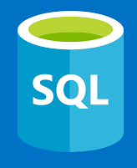
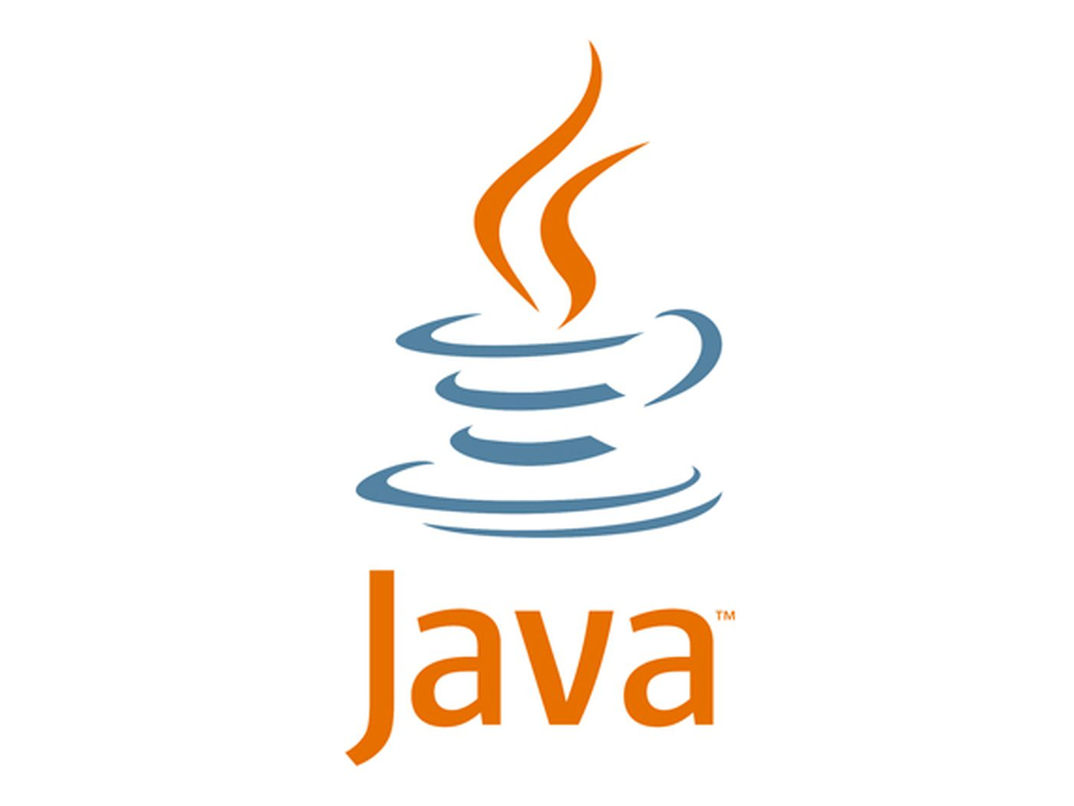

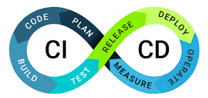
Copyright © 2021 by Madhurima Nath
Tech stack for data engineers
Languages: SQL, NoSQL, Python, Java, Scala
Spark, Databricks, Kafka, Hadoop, CI/CD* framework
*CI/CD: Continuous Integration Continuous Deployment
Disclaimer: These can change based on companies/industry

Slide 46


• WWCode Presentation and Demo • WWCode YouTube channel for session recordings.
Resources: spark documentation databricks documentation snowflake documentation azure data engineer certification course google cloud data engineer certification course aws big data certification Udacity data engineering interview questions
Backend Study Group

